Slide 1

  Session 1

Slide 2
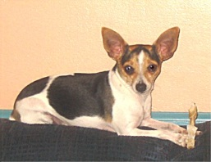

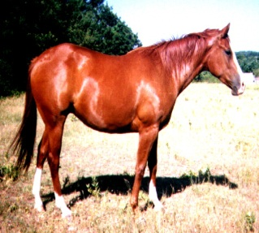

Object
Shapes
Mammals

Slide 3
A Dog has name,
It has some color,
It belongs to a breed,
It may be hungry.
name , color, breed, hungry are the attributes of Dog object.
Dog can bark, search, eat ……..
Bark, search, eat define some behaviour of Dog object.
Behavior (Doing Responsibility) is how an object reacts, in terms of its state changes, in response to operations performed upon it.

Slide 4
Class
Class Defines the attributes and behaviour of the objects.
Class is the blueprint of the objects.
Objects are physical entity and class is the logical construct of the objects.
An object has some states.
State(Knowing Responsibility) is a set of properties which can take different values at different times in the object’s life.
Every object has an unique identity number.

Slide 5
Object has following characteristics-
        State
        Behavior
        Attributes
        Identity

Slide 6
Java Objects & Class Contd.
Example:
Mr. White is married. He teaches OO Software Engineering classes on Fridays. He is a part-time member of the faculty at the CS Department of the All-Smart Institute. John is enrolled in the OOSE class that Mr. White teaches. Mrs. White uses a Nano for transportation to and from the campus (she teaches Philosophy at the same institute). Class size is limited at the institute to 14 students. Janet, the sister of John is enrolled for violin course in the same institute.
Identify all the objects & Similar
Objects / Class or Type that defines the objects …

Slide 7
Java Objects & Class Contd.
OBJECTS are:
Mr. White
Faculty
Mrs. White
Faculty
John
Student
Janet Student
Nano
Car
Philosophy
Department
CS
Department
All-Smart
Institute
OOSE
Course
Violin
Course

Slide 8
Properties of Object Orientated Programming (OOP)
Common properties of OOP is given below-
Abstraction
Encapsulation.
Inheritance.
Polymorphism.

Slide 9
Java as Object Orientated Programming
Java Source Code(.java file)
Java Compiler (javac)
Bytecode (.class file)
JVM
JVM
JVM
Interpreter
Interpreter
Interpreter
Windows
Unix
Mac
Executable file(Output)

Slide 10
Example Java program to print “HELLO WORLD”
class exampleHW
{
public static void main (String args[])
{
System.out.println (“HELLO WORLD” );
}
}

Slide 11
Java Programming Elements Contd.
Datatype Size
byte 8 bits
short 16 bits
int 32 bits
long 64 bits
float 32 bits
double 64 bits
Character takes 16 bits(Unicode), and size of the
Boolean data type is machine dependent.

